Slide 1
Data Design Class #1 Unrelated Transforms
Mike Acton 29 Mar 2010

Slide 2
What is an unrelated transform?
Source data
Transforms
Destination data

Slide 3
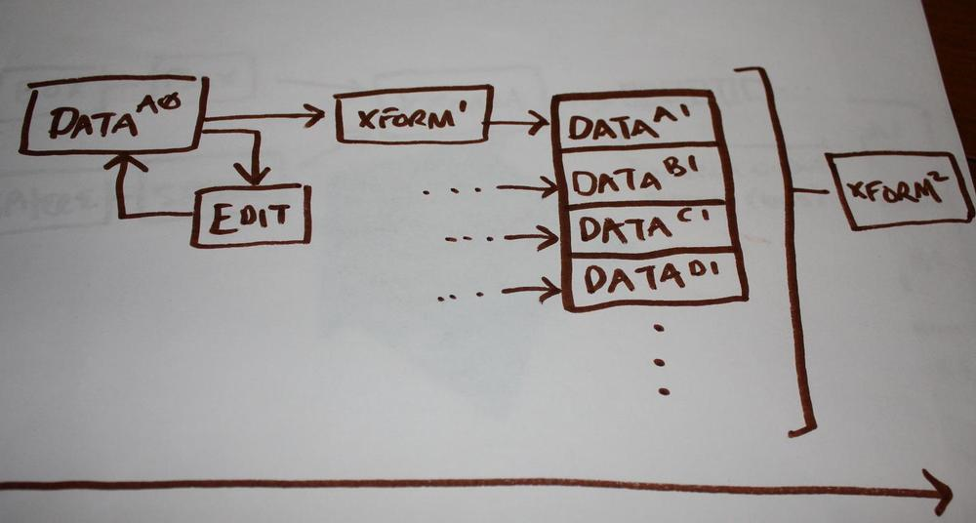
Solving related transforms is intuitive
Data design fundamental: Two different problems imply two different data designs.

Slide 4
Implication: Transform equality
Not all transforms are equal!
Throughput requirements (call rate)
Latency requirements
Data access
Transform is always paired with input and output data

Slide 5
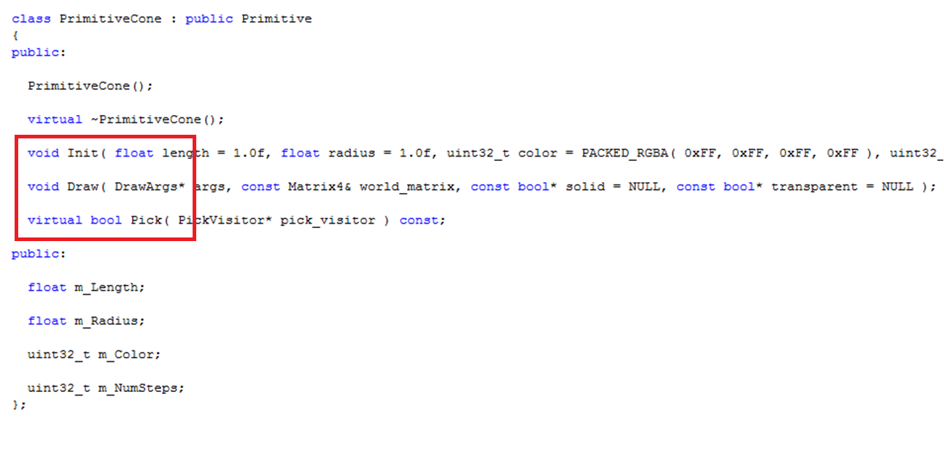

Slide 6
Implication: Spaghetti data
Much worse than spaghetti code!
Unclear access patterns
Unnecessary locking
DCache thrashing
The reason why cache sizes are bloated in h/w
No statistical relationship

Slide 7
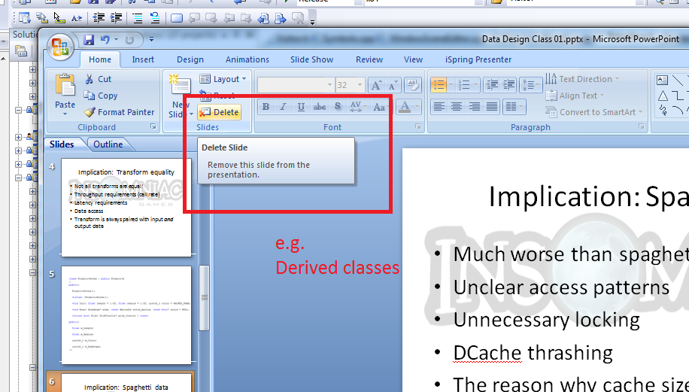

Slide 8
Implication: Monolithic structs
Poor memory characteristics
Unknown usage patterns
Transactions unclear

Slide 9
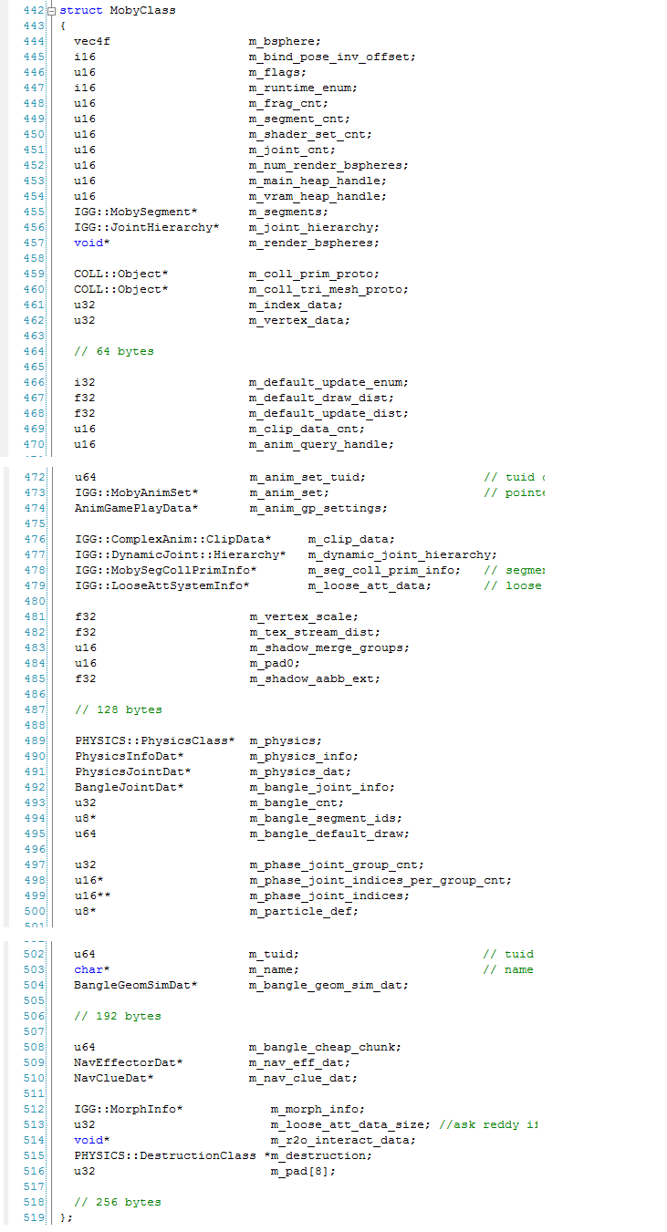
MobyClass
Note: Compare components

Slide 10
Implication: Classification flags
Need to distinguish cases
A lot of additional implicit state machines
Unnecessary checks/tests
Additional points of failure
Nonsense combinations

Slide 11
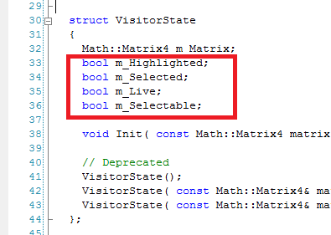

Slide 12
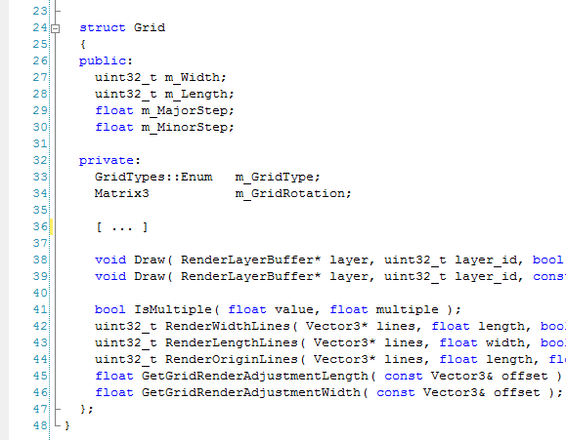

Slide 13
Implication: Unnecessary virtuals
Asking the wrong question:
Don’t ask: “What does this do?”
Ask: “What am I doing with this data?”

Slide 14
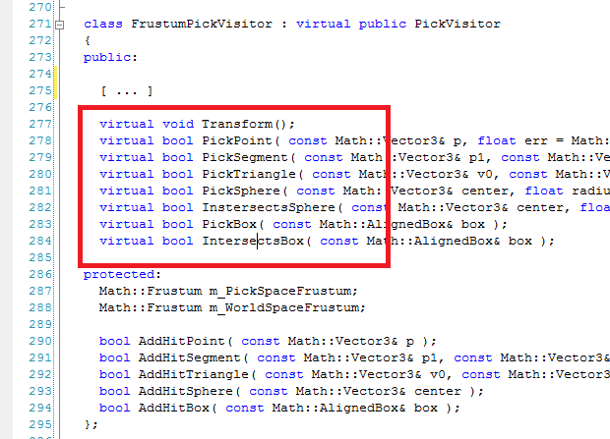

Slide 15
Implication: Unoptimizable
Obvious: Global optimizations more valuable than local ones.
Data not organized on global access patterns can’t be globally optimized.

Slide 16
Implication: Poor concurrency
Short answer: Can’t.
Typical solution must enforce sequence.
i.e. Over-locking

Slide 17
Implication: Code > Data
Bears repeating:
We do not write code.
We transform data.
Code is a tool to do that.

Slide 18
Discussion Topic
“Visitor Pattern”

